Slide 1
Travel Planner Agent (PlanMate)
CAPSTONE PROJECT
Presented By:
Venkatraman Athimuthu -Kalasalingam academy of research and education -Computer Science and Engineering

Slide 2
OUTLINE
Problem Statement
Proposed System/Solution
System Development Approach
Algorithm & Deployment
Result
Conclusion
Future Scope
References

Slide 3
Problem Statement
Planning a trip involves balancing multiple factors such as destination selection, budget, duration,accommodation, transport, and weather conditions. With vast and unorganized information available online, travelers often face confusion and delays in making informed decisions, leading to inefficient or unsatisfying travel experiences. To enhance convenience and optimize travel planning, it is essential to provide a smart, AI-powered assistant that understands user preferences, constraints, and real-time data. The core challenge is to intelligently generate personalized suggestions, itineraries, and travel options, ensuring a smooth, customized, and efficient trip planning experience for every user.

Slide 4
Proposed Solution
To tackle the challenge of delivering personalized and actionable eco-friendly suggestions, the proposed solution is an intelligent Travel Planner Agent
using IBM WatsonX AI, WatsonX Runtime on IBM Cloud.
Architecture Overview
The system is designed to combine retrieval and generation of information:
Generation: Uses IBM Granite foundation models to generate user-friendly answers based on the retrieved content.
Key IBM Cloud Components
WatsonX.ai Studio: Used to build and fine-tune the LLM-based pipeline.
WatsonX Runtime Service: Executes the Granite LLM and manages runtime inferencing of user prompts in real-time.
Cloud Object Storage (COS): Stores raw documents and structured datasets used for knowledge grounding.

Slide 5
System Approach
The System Approach outlines the strategy and components used in building theTravel Planner Agent. It includes system requirements, development tools and necessary libraries to ensure a smooth and functional deployment of the solution.
1. System Requirements
Internet: Stable connection for cloud integration and deployment
Software:
Operating System: Windows 10/Linux/macOS
Browser: Chrome, Firefox, or Edge for accessing the IBM Cloud
IBM Cloud
WatsonX Assistant (on IBM Cloud)
2. Libraries and Tools Required
Deployment Tools:
Git
IBM Cloud

Slide 6
Algorithm & Deployment
Algorithm: Travel Planner Agent
The Travel Planner Agent uses user input parameters to generate customized travel recommendations by processing structured and unstructured travel data using AI models.
User Query Input
The user enters a travel-related query such as preferred location, budget, duration, and interests (e.g., “Plan a 3-day trip to Kerala under ₹10,000”).
Parameter Extraction
Key parameters like destination, duration, budget, and travel type are extracted.
Data Matching and Filtering
Filters are applied to shortlist suitable destinations, accommodations, and transport routes.
Response Generation
A structured travel plan is generated in natural language.
User Output Delivery
The response is displayed in the chat interface for user review.
Deployment: Travel Planner Agent
WatsonX.ai Studio – To develop, test, and run the Travel Planner Agent.
WatsonX Runtime – To handle real-time execution of the AI model.
Cloud Object Storage – For storing location data, itinerary templates, destination guides, and price lists

Slide 7
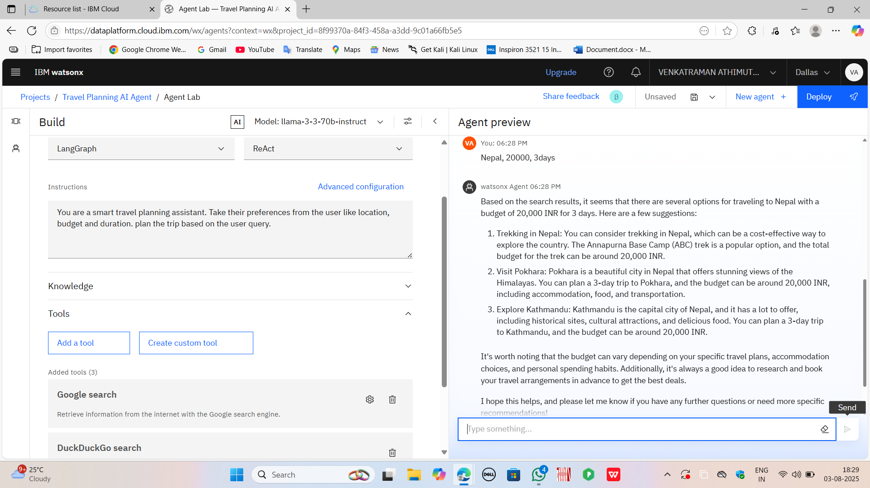
Result
The Travel Planner Agent effectively fulfills its goal of simplifying and personalizing the travel planning process through AI-driven assistance. When users provide inputs such as destination preferences, budget, duration, or travel style, the agent intelligently generates customized travel suggestions, including recommended places to visit, accommodation options, transportation methods, and itinerary plans. The system integrates real-time data such as weather, local attractions, and seasonal trends to enhance the relevance and usefulness of its recommendations..

Slide 8
Conclusion
The Travel Planner Agent presents an innovative AI-driven solution to simplify and personalize the process of planning trips. By leveraging real-time data, user preferences, and intelligent recommendation systems, it addresses the common challenges faced by travelers such as information overload, time constraints, and uncertainty in decision-making. This assistant not only enhances user convenience but also ensures optimized travel experiences tailored to individual needs. As the system evolves, it holds the potential to transform travel planning into a seamless, interactive, and intelligent process, setting a new standard for modern travel assistance.

Slide 9
Future scope
The Travel Planner Agent can be significantly enhanced in future iterations to provide an even more immersive and intelligent experience. Integration with real-time APIs for flight, train, and hotel bookings would enable end-to-end travel planning and execution. Incorporating user authentication and profile history can allow for deeper personalization, including travel style prediction and repeat traveler recommendations.

Slide 10
References
IBM Cloud Documentation https://cloud.ibm.com/docs
IBM Cloud Object Storage https://www.ibm.com/cloud/object-storage
Granite Foundation Models – IBM https://www.ibm.com/blog/granite-generative-foundation-models/
WatsonX.ai Studio – IBM Cloud Platform https://dataplatform.cloud.ibm.com

Slide 11
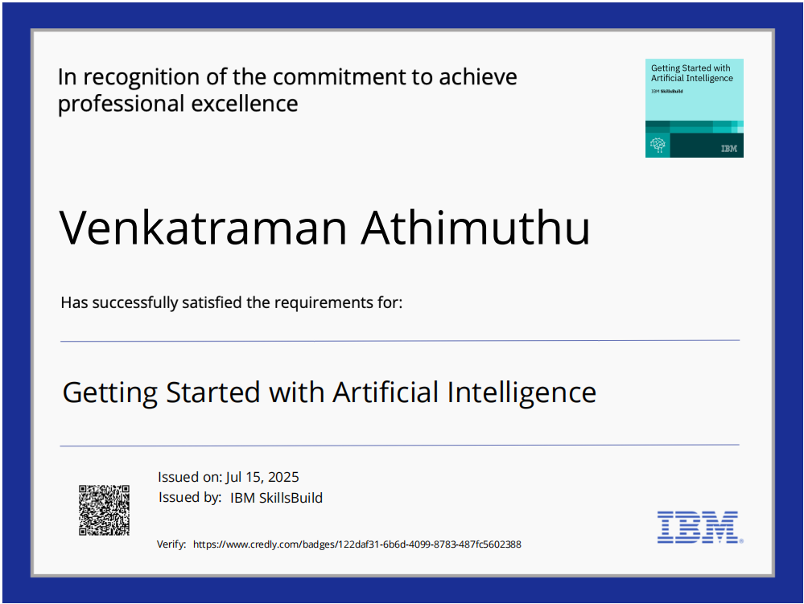
IBM Certifications

Slide 12
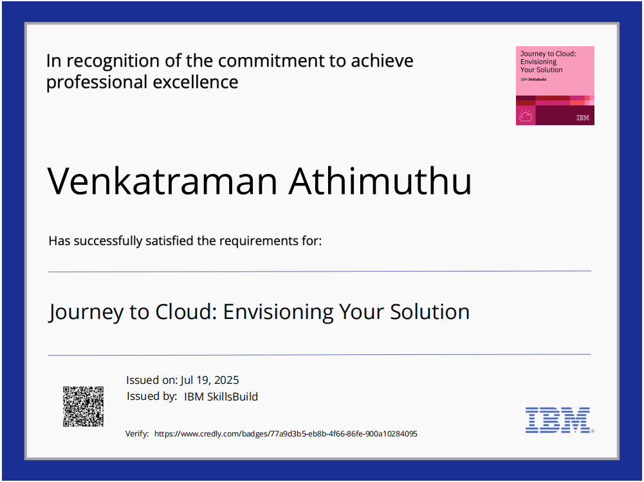
IBM Certifications

Slide 13
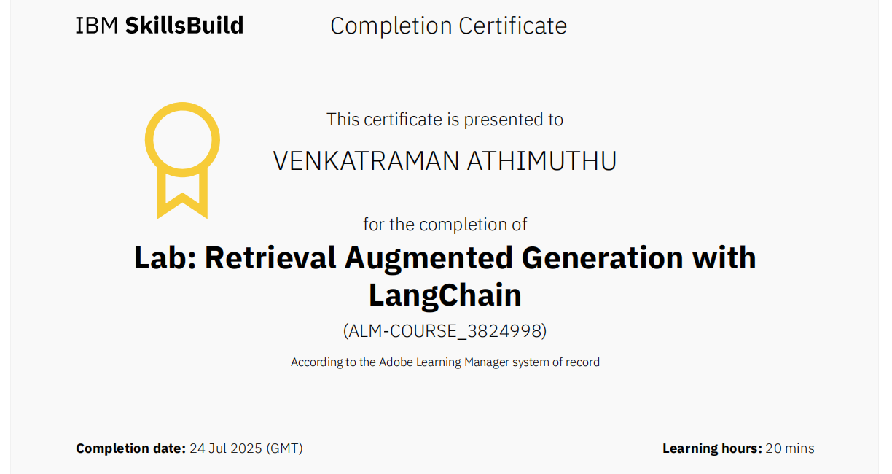
IBM Certifications

Slide 14
THANK YOU

